Slide 1
Recurrent World Models Facilitate Policy Evolution
Sankalp Sanand (A20448061) ssanand@hawk.iit.edu
Arinjay Jain (A20447307) ajain80@hawk.iit.edu

Slide 2
Problem Statement
Can agents learn inside of their own dreams? Building generative neural network models of popular reinforcement learning environments. Our model can be trained quickly in an unsupervised manner to learn a compressed spatial and temporal representation of the environment. By using features extracted from the world model as inputs to an agent, we can train a very compact and simple policy that can solve the required task.

Slide 3
Reinforcement Learning
Reinforcement Learning (RL): Provide the learning agent with a reward function
and let it figure out the best strategy for obtaining large rewards.

Slide 4
Objectives of the project
Re-obtain the results achieved by the recurrent world models in DoomTakeCover environments.
Evaluate how these models perform in gaming environments where complexity in terms of actions available to the agent, information visible to the agent, effect of non playable characters on the agent, and challenges involved in order to proceed further in the game is much higher than the environments the model has been tested in.
Develop a generalized agent which can utilize transfer learning and the new perception model in order to decrease its required training time to solve never before encountered but abstractly similar environments.

Slide 5
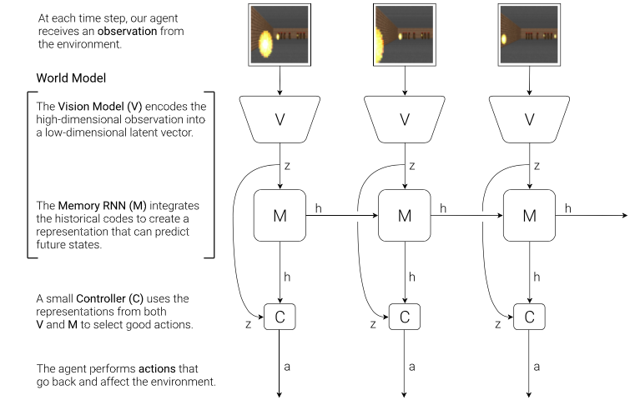
Implementation details

Slide 6
Variational Autoencoder (VAE) (V) Model
The environment provides our agent with a high dimensional input observation at each time step. This input is usually a 2D image frame that is part of a video sequence. The role of the V model is to learn an abstract, compressed representation of each observed input frame.

Slide 7
Mixture Density Network MDN-RNN (M) Model
While it is the role of the V model to compress what the agent sees at each time frame, we also want to compress what happens over time. For this purpose, the role of the M model is to predict the future. The M model serves as a predictive model of the future z vectors that V is expected to produce.

Slide 8
Controller (C) Model
The Controller (C) model is responsible for determining the course of actions to take in order to maximize the expected cumulative reward of the agent during a rollout of the environment.
In our experiments, we deliberately make C as simple and small as possible, and trained separately from V and M, so that most of our agent’s complexity resides in the world model (V and M).

Slide 9
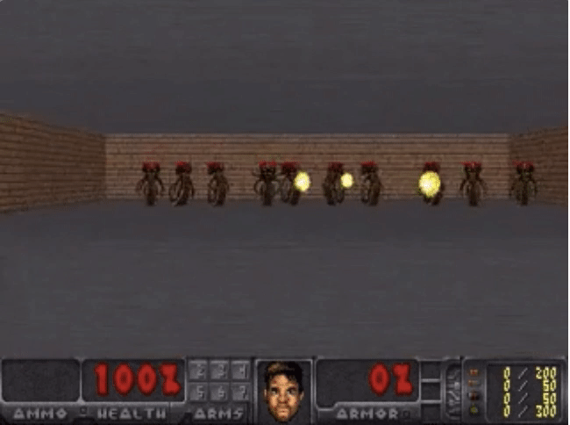
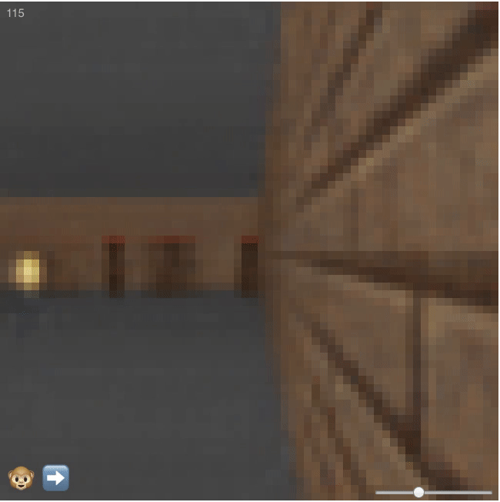
The Game being used – DoomTakeCover
In this game the objective is to dodge
the fireballs being thrown at the player
and last as long as possible.
Generated dream environment

Slide 10
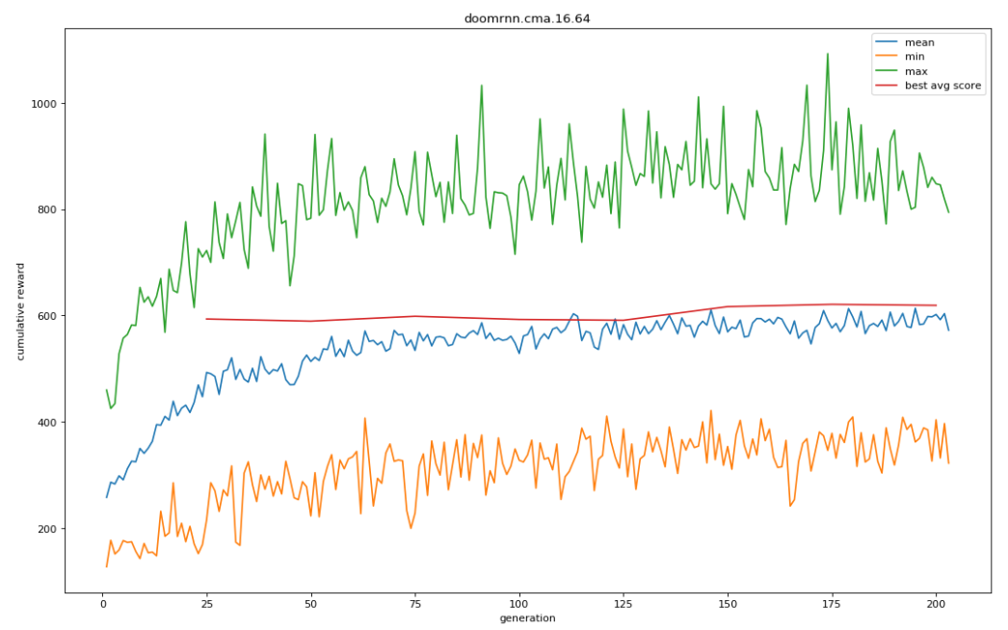
Results
While training in dream environment, these results were obtained.
On the real environment average score after training on a 64 core machine for 200 generations is 821 and on a 24 core machine for 500 generations 838.58

Slide 11
Future enhancements
Factor of curiosity in the agent.
Implementation on more complicated games.
Interpolation between multiple related environments.
Extracting the essence of the task without worrying about the unnecessary details.

Slide 12
Thank you
Questions?

